Slide 1
Robotic Stirred Tank Reactor System
Xiaoguang Wang
Jagannathan Alagurajan
Roy J. Carver Department of Biochemistry, Biophysics and Molecular Biology
Iowa State University

Slide 2
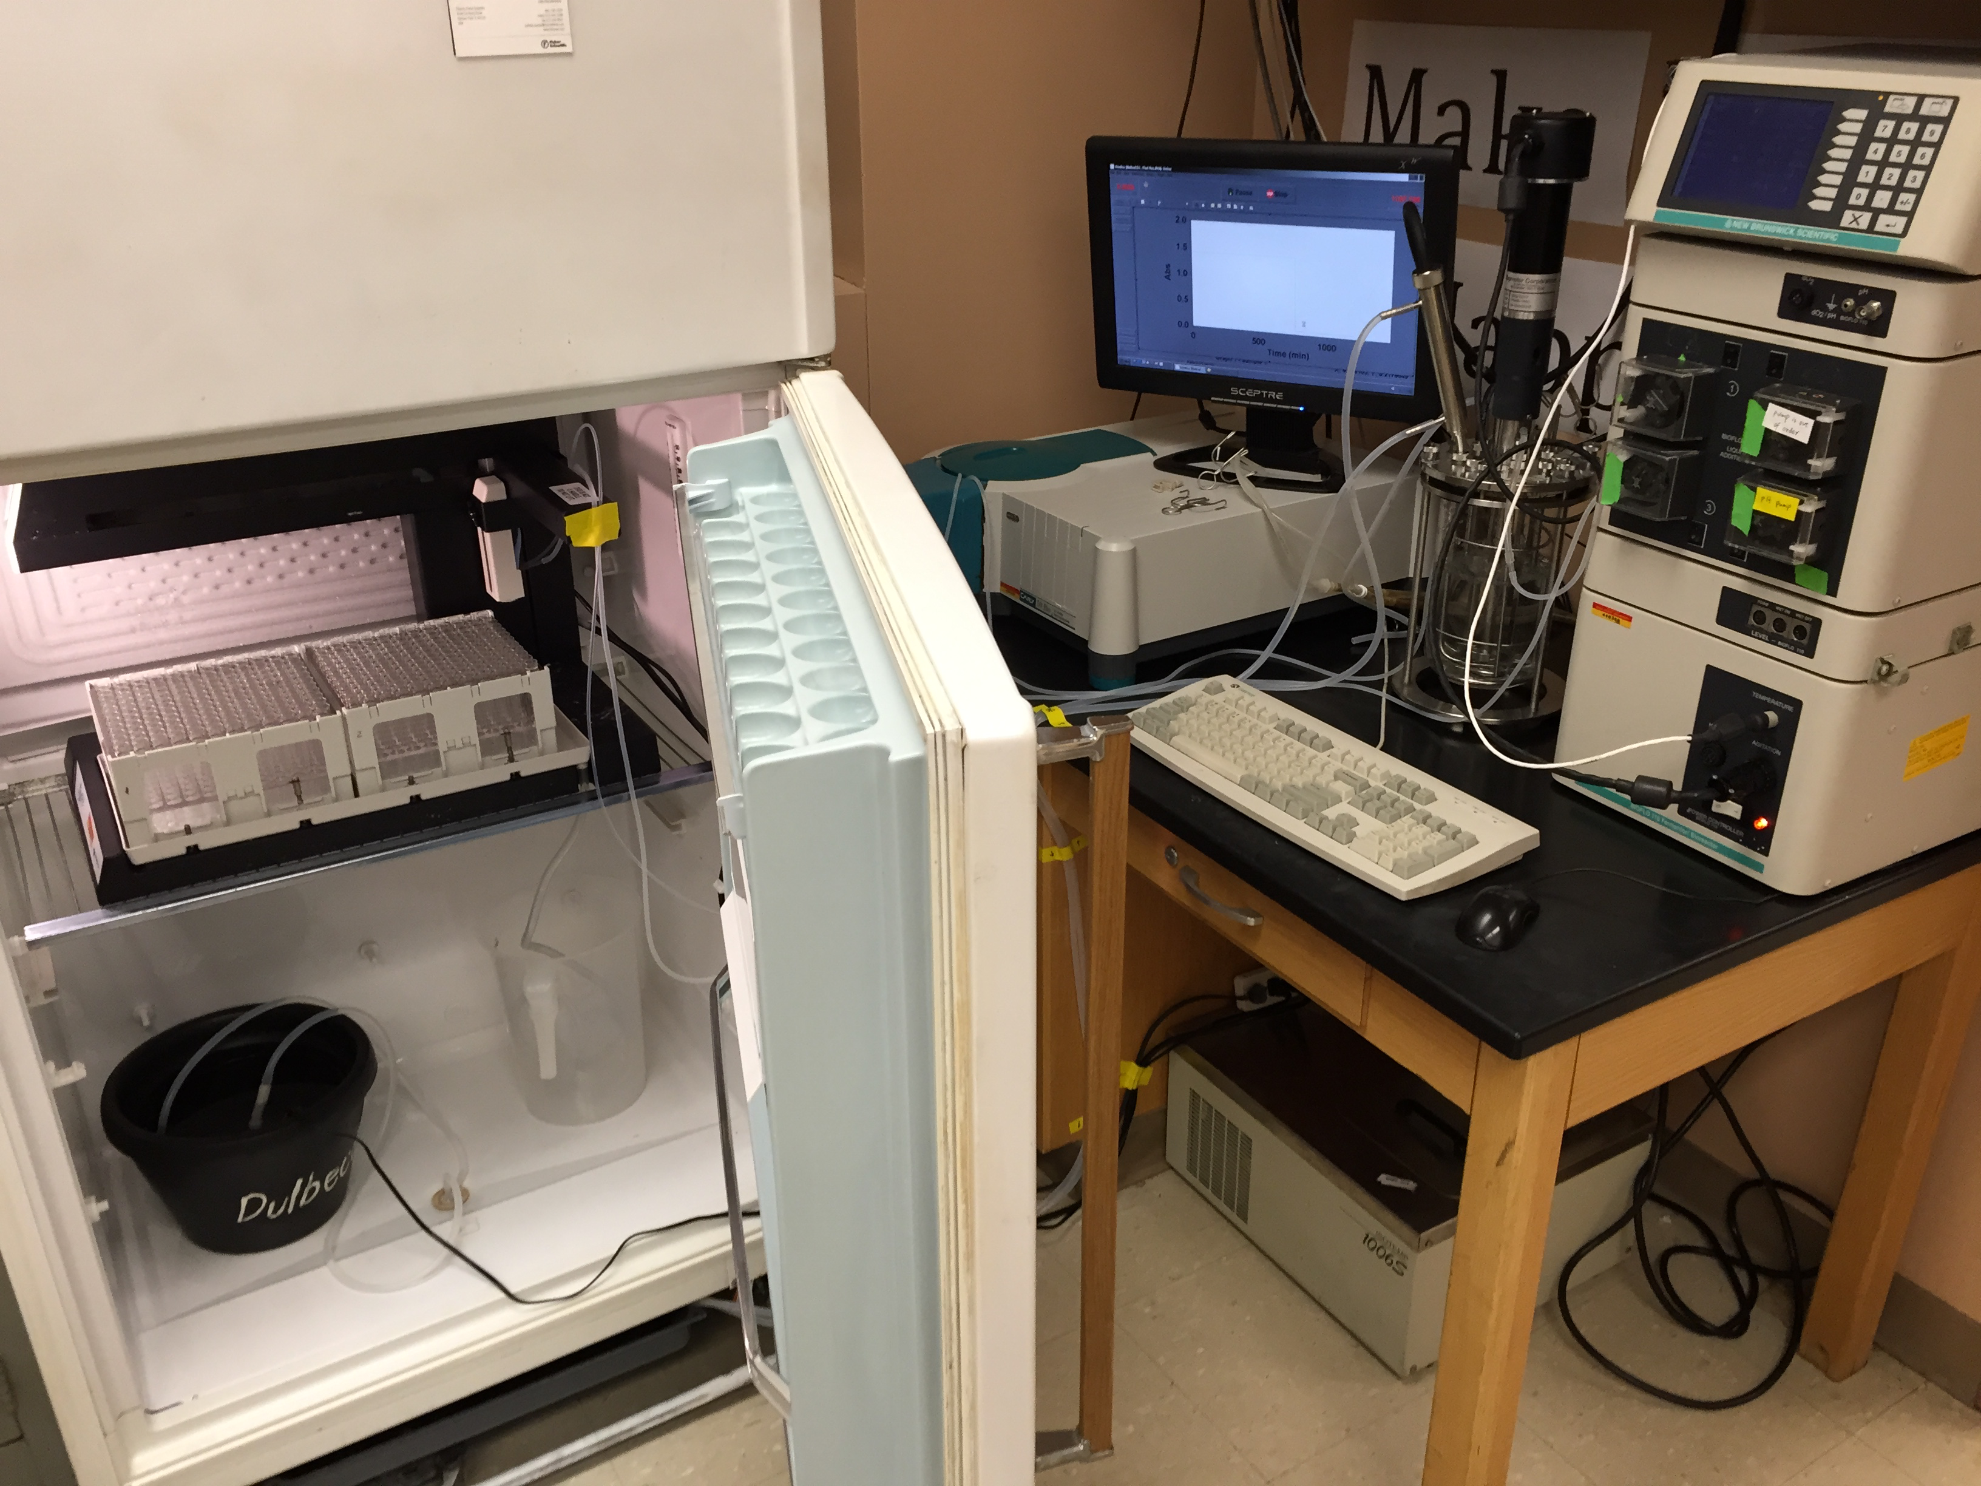
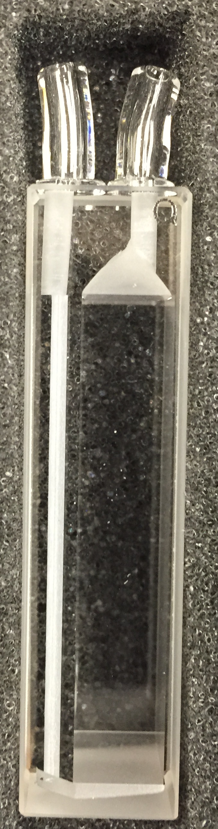
New Brunswick BioFlo 110
Automated Growth Monitoring
Automated Sampling
Notes:
Cary 50
Foxy R2
Reason for automation:
150 hours multi stage fed batch growth
Fed small amount of nitrite every 1 hour for 12 hours
$50,000, 2 weeks
$500, 1 week
Improve quality of data
Make the process sustainable

